Slide 1
Retrieval Augmented Generation (RAG)
Lai Chun Wai (BE IE MSA ADA)
12 November 2024

Slide 2
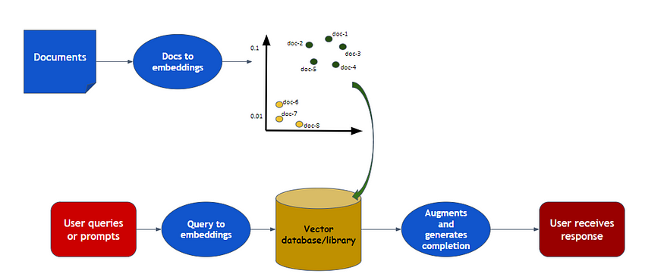
How RAG Works?
Text Embedding
(Document Similarity)
Text Generation is mainly rely on the Embedding Result!!!
LLM
(Text Generation)

Slide 3
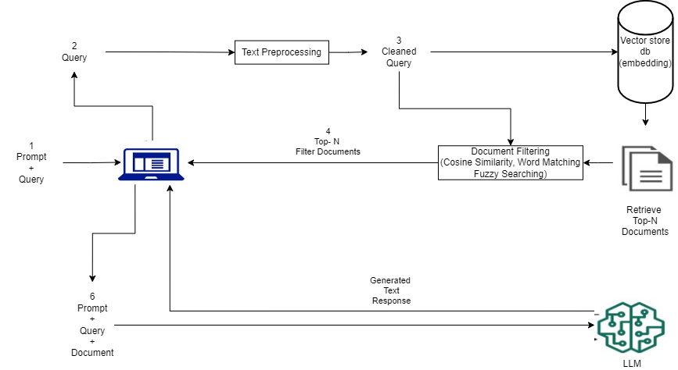
Updated RAG Workflow

Slide 4
Common Mistakes or Problem When Create RAG
Problem | Description
Information Loss | The related information is not storing inside the database
Missing High Ranking Documents | Retrieval is a small searching engine, so hard to get an accurate result. Sometimes the answers didn’t return the existed answers from the k documents by the retrieval.
Can’t Retrieved Useful information | Different LLM consist of different Language Understanding Capabilities
LLM Parameters Setting | LLM had to be choose appropriate hyperparameter setting when using it
Inappropriate QA | Commonly happened in different background of users, sometimes the prompt enter by users are too general and not specific will cause different variation of answers.

Slide 5
Ways to improve
Ways
Perform Data Cleaning
Hyperparameter, top k searching and overlapping setting
Optimize and Improve the prompting
LLM fine tuning (Costly)

Slide 6
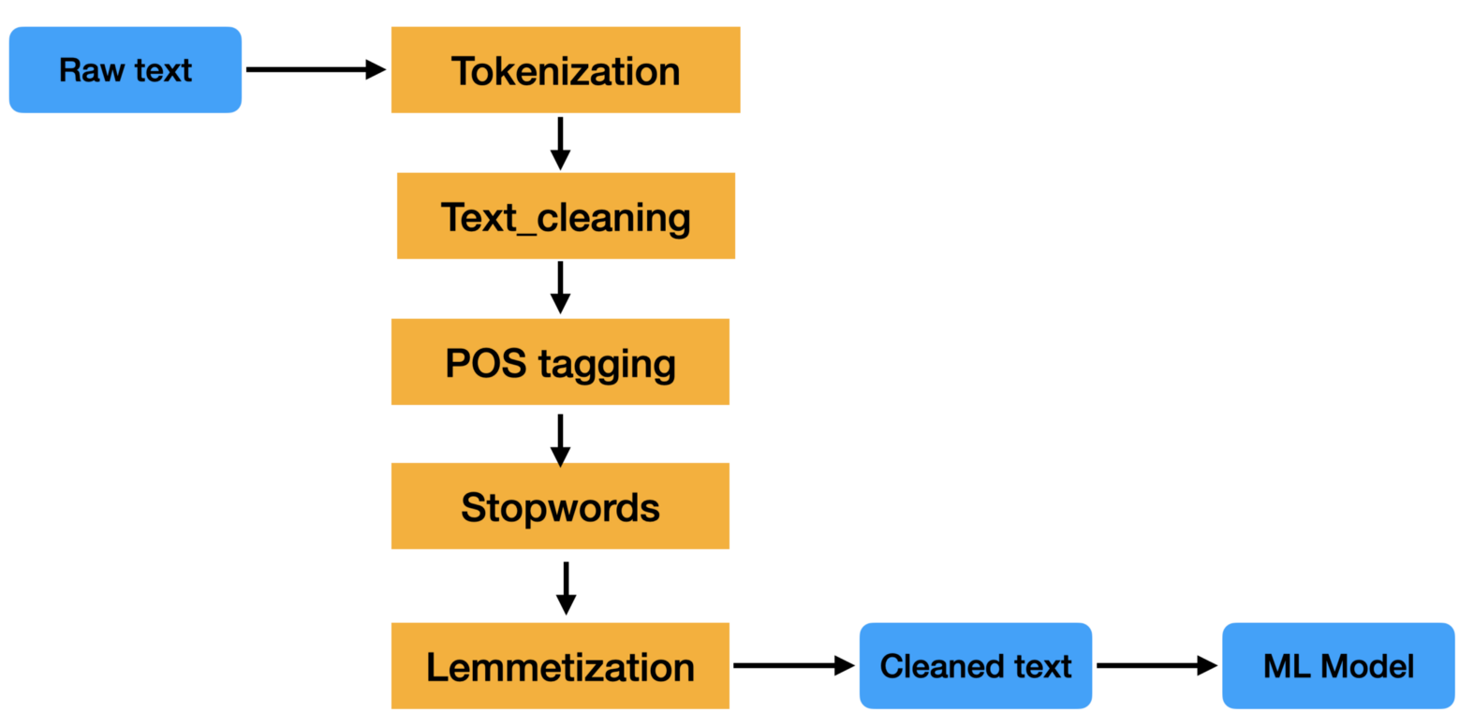
NLP Pipeline

Slide 7
Data Quality Issues
Problem | Description
Inconsistent Terminology | Use of different terms to refer the same concept or entity (e.g., “IFX” vs “Infineon”)
Inconsistent Formatting | Variation in text format, (e.g., spacing, capital letter, punctuation)
Grammatical Errors | Incorrect grammar
Redundancy and Repetition | Repeated phrases or sentence within the text

Slide 8
Text Preprocessing
Technique | Use Cases
Tokenization | Splitting text into individual tokens such as words, phrases, or sentences.
Lowercasing | Converting all characters in the text to lowercase to ensure uniformity.
Removing Punctuation | Simplifies the text and focuses on the core words.
Removing Stop Words | Reduces (“and”, “the”, “a”) the dimensionality of the text data and focuses on more informative words.
Stemming | Reduces related words to a common base form, simplifying the analysis. (e.g., “testing” to “test”)
Text Normalization | Converting text into a standard format. (e.g., “IFX” to “Infineon”)
Removing Extra Whitespaces | Ensures text is clean and uniformly spaced.
Removing Unnecessary Numbers and Character | Cleans up the text, removing irrelevant characters that may interfere with embeddings.

Slide 9
Integrating Document Filtering
Technique | Use Cases
Metadata Filtering | Filter documents based on metadata attributes (e.g., package, fmea_id) that are relevant to the query.
Keyword Filtering | Filter documents that contain specific keywords or phrases found in the query. This can be done using techniques such as TF-IDF or simple keyword matching.

Slide 10
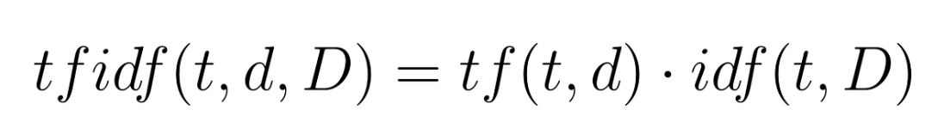
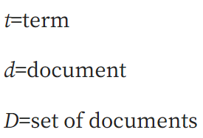
TF-IDF

Slide 11
Terms Frequency (TF)
tf(t,d) = count of t in d / number of words in d
It is a measure of how frequently a specific word (term) appears in a document. Higher frequency indicates greater relevance of the term within that document.
Document Frequency (DF)
df(t) = N(t)
where
df(t) = Document frequency of a term t
N(t) = Number of documents containing the term t
It refers to the number of documents in a collection that contain a specific term.

Slide 12
Document Frequency (DF)
df(t) = N(t)
where
df(t) = Document frequency of a term t
N(t) = Number of documents containing the term t
It refers to the number of documents in a collection that contain a specific term.
Inverse Document Frequency (IDF)
idf(t) = log(N/ df(t))
It is a measure used to evaluate the importance of a term. IDF decreases the weight of terms that appear very frequently in many documents and increases the weight of terms that appear less frequently, making rare terms more significant for distinguishing documents.

Slide 13
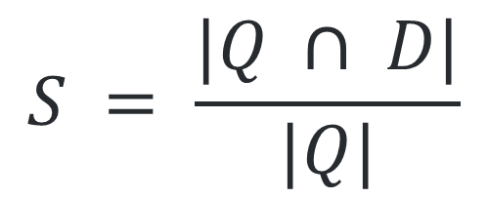
Word Matching
$$S = \frac{|Q ∩ D|}{|Q|}$$
S = Matched Word Score
Q = Set of word in the Query
D = Set of word in the Document
|Q| = Cardinality of Q
|Q ∩ D| = Cardinality of the intersection of Q and D

Slide 14
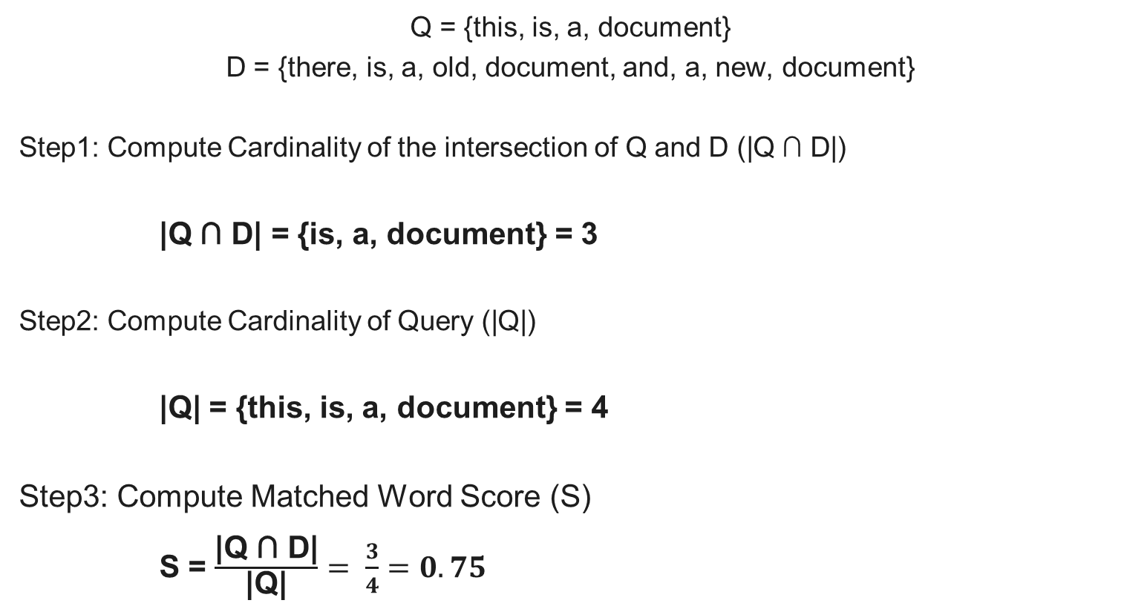
Word Matching
Q = {this, is, a, document}
D = {there, is, a, old, document, and, a, new, document}
Step1: Compute Cardinality of the intersection of Q and D (|Q ∩ D|)
|Q ∩ D| = {is, a, document} = 3
Step2: Compute Cardinality of Query (|Q|)
|Q| = {this, is, a, document} = 4
Step3: Compute Matched Word Score (S)
S = $\frac{\text{|}\text{Q}\text{ ∩ }\text{D}\text{|}}{\text{|}\text{Q}\text{|}}= \frac{3}{4}=0.75$

Slide 15
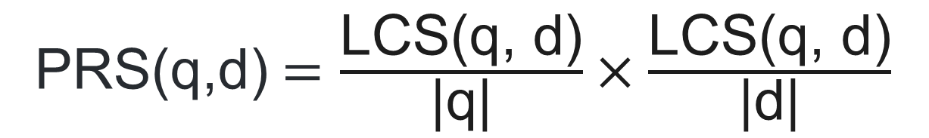
Word Matching (Partial Ratio Score)
PRS(q,d)$=\frac{\text{LCS}\text{(}\text{q}\text{, }\text{d}\text{)}}{\text{|}\text{q}\text{|}}×\frac{\text{LCS}\text{(}\text{q}\text{, }\text{d}\text{)}}{\text{|}\text{d}\text{|}}$
PRS(q,d) = Partial Ratio Score between Query and Document
q = set word in the Query
d = set word in the Document
LCS(q,d) = Longest Common Subsequence between q and d
|q| = Cardinality of q
|d| = Cardinality of d

Slide 16
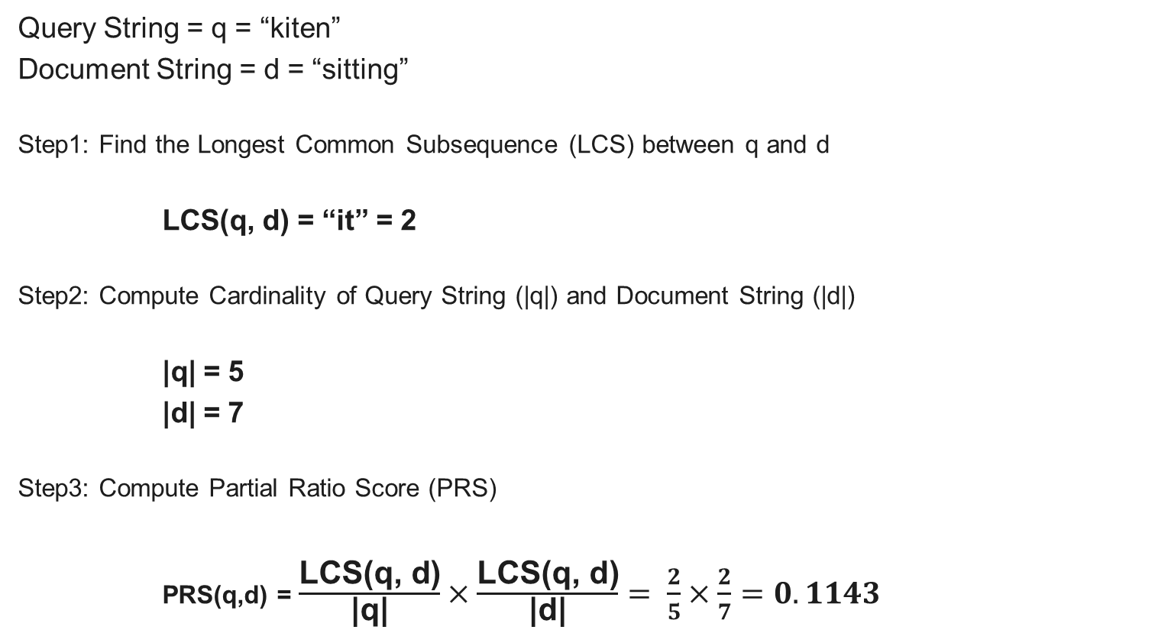
Fuzzy Search
Query String = q = “kiten”
Document String = d = “sitting”
Step1: Find the Longest Common Subsequence (LCS) between q and d
LCS(q, d) = “it” = 2
Step2: Compute Cardinality of Query String (|q|) and Document String (|d|)
|q| = 5
|d| = 7
Step3: Compute Partial Ratio Score (PRS)
PRS(q,d) = $\frac{\text{LCS}\text{(}\text{q}\text{, }\text{d}\text{)}}{\text{|}\text{q}\text{|}}×\frac{\text{LCS}\text{(}\text{q}\text{, }\text{d}\text{)}}{\text{|}\text{d}\text{|}}= \frac{2}{5}×\frac{2}{7}=0.1143$

Slide 17
References
References
https://juejin.cn/post/7369853533888626699
https://tech-mags.com/understanding-natural-language-processing-pipeline/
https://towardsdatascience.com/how-tf-idf-works-3dbf35e568f0
https://www.geeksforgeeks.org/understanding-tf-idf-term-frequency-inverse-document-frequency/

Slide 19
Text Preprocessing (Optional)
Technique | Use Cases
Named Entity Recognition (NER) | Identifying and classifying named entities (e.g., person names, locations, dates).
Part-of-Speech (POS) Tagging | Assigning parts of speech to each word (e.g., noun, verb, adjective).

Slide 20
What is Retrieval Augmented Generation (RAG)?
 | Description
Definition | Optimizes large language model (LLM) outputs by referencing an authoritative knowledge base outside of its training data sources before generating responses.
Purpose | Enhances the relevance, accuracy, and utility of LLM outputs in specific domains or organizational knowledge bases.
Application | Answering questions, translation, sentence completion, etc.

Slide 21
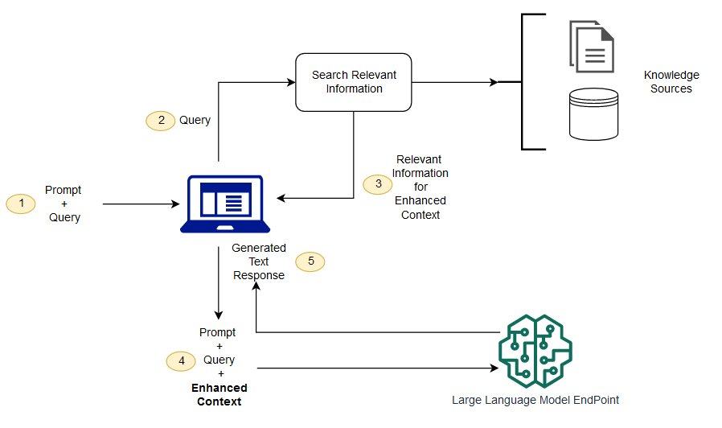
How RAG Works?

